Slide 1


Slide 2

Yes I do
Ous website specializes in full service wedding and event design & coordination.
Our Goal:
Is to make your event memorable by providing excellent services through low cost solutions & help you achieve both your personal & business goals through reliability.

Slide 3
Services
Marketing
Mix
7 P's

Slide 4
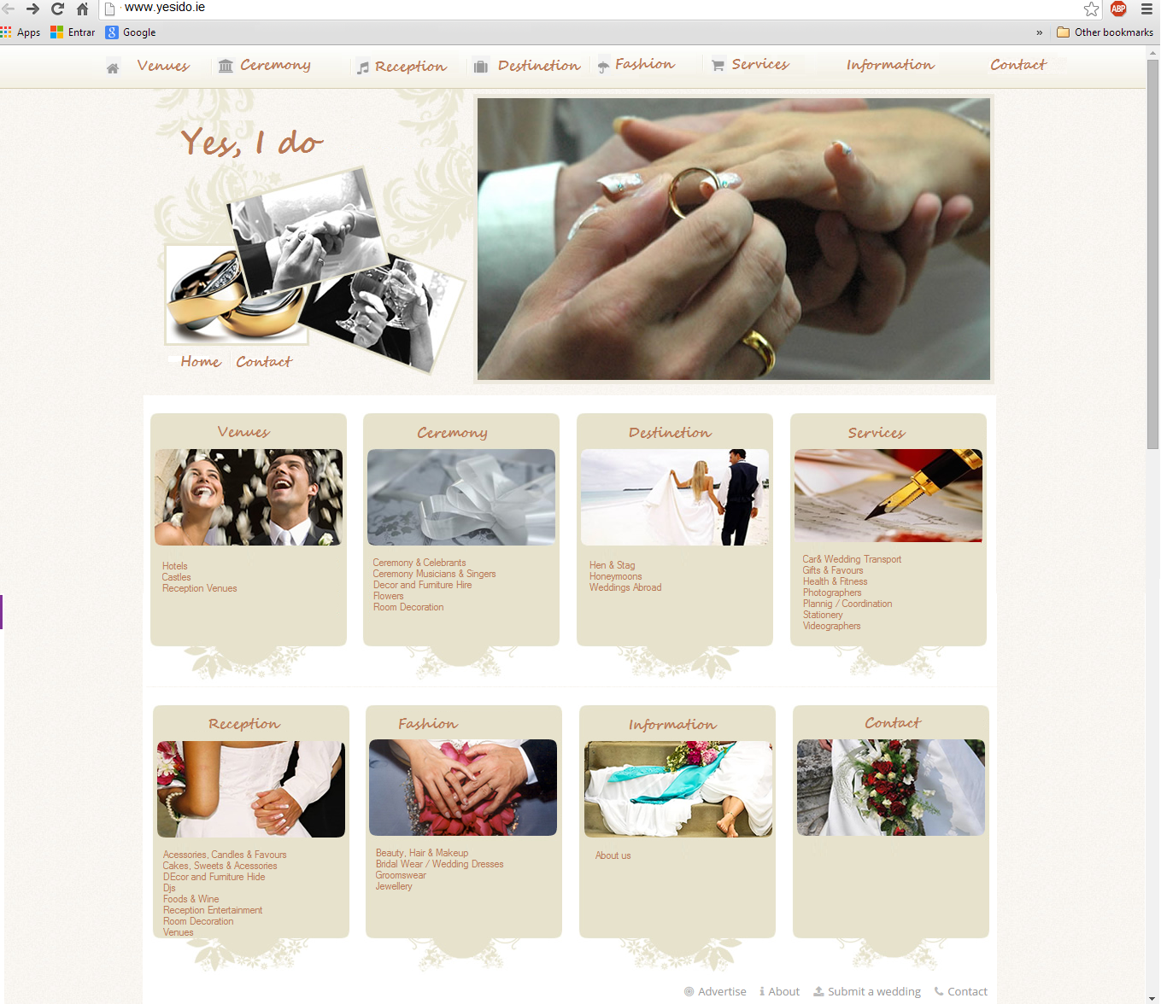
Product

Slide 5
Price
Skimming
Penetration
Valeu Based
Cost Plus
Cost Leadership

Slide 6
Place
Internet
Retaill
Wholesale
Mailorder
Direct Sales
Peer to peer
Multi=channel

Slide 7
Promotion
Special Offers
Advertisements
Endorsements
User triais
Campaigns
Joint vetures

Slide 8
People
Employess
Management
Organization Culture
Customer service
Orientation

Slide 9
Process
Uniformity of offering
Service delivery
Service consumption

Slide 11
Happy Forever!!!
End....

